Slide 1

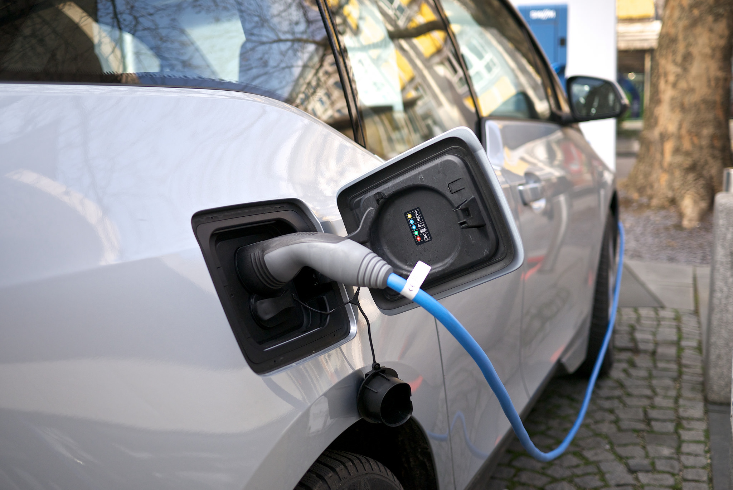
Analysis of Electric Vehicle Trends Over the Last Decade

Slide 2

Agenda
-Examine the overall growth in the EV sales
-Factors influencing the grow of EV and Plug-In Hybrid
- Identify the makers of best selling EV’s and features of them
- Identify the most sold EV’s and the features of them

Slide 3


Introduction
Over the last decade, the automobile industry has witnessed a huge increase in electric vehicle population. As we proceed further, we will analyze a few factors that have influenced this surge. We also analyze the features of the maximum cars sold

Slide 4
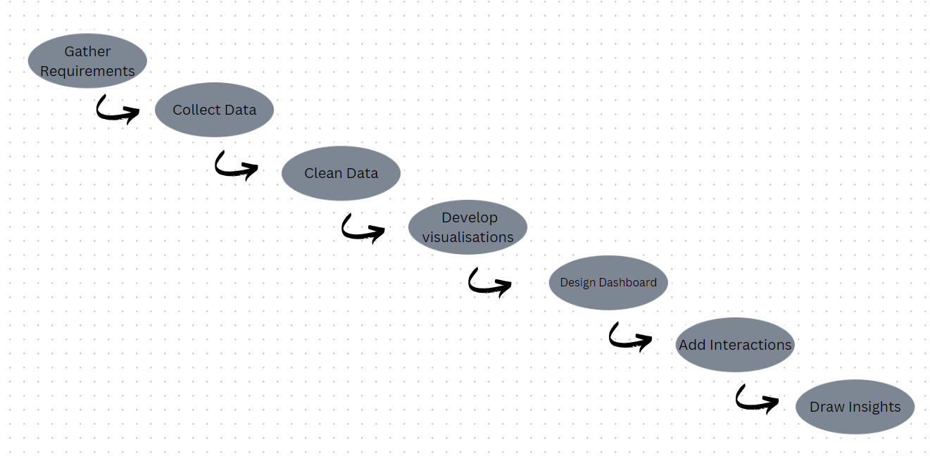
Steps Followed

Slide 5

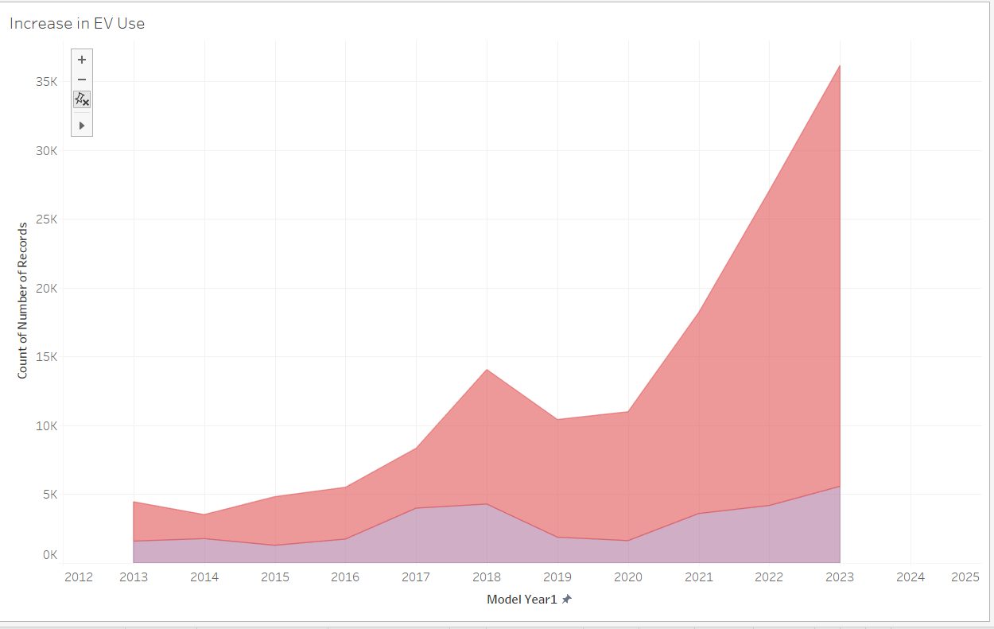
The EV Trend

Slide 6
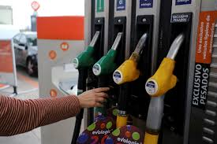
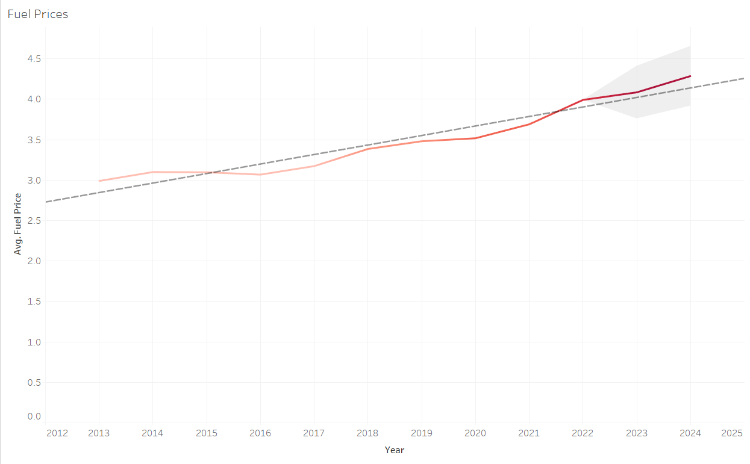
Fuel Prices over the last decade

Slide 7
State Incentives
State Full | Incentive
Georgia | 500
Hawaii | 500
Montana | 500
Nebraska | 500
Ohio | 500
Iowa | 600
Wisconsin | 600
Arizona | 1,000
Florida | 1,000
Kansas | 1,000
Missouri | 1,000
Illinois | 4,000
State Full | Incentive
New Mexico | 1,000
Tennessee | 1,000
Mississippi | 1,250
Indiana | 1,500
Louisiana | 1,500
Nevada | 1,500
New Jersey | 1,500
Pennsylvania | 1,500
North Dakota | 1,850
New York | 2,000
North Carolina | 2,000
Colorado | 5,000
State Full | Incentive
Rhode Island | 2,000
Washington | 2,000
South Dakota | 2,300
California | 2,500
Massachusetts | 2,500
Oregon | 2,500
South Carolina | 2,500
Texas | 2,500
Maryland | 3,000
Delaware | 3,500
New Hampshire | 3,500
Maine | 7,500

Slide 8
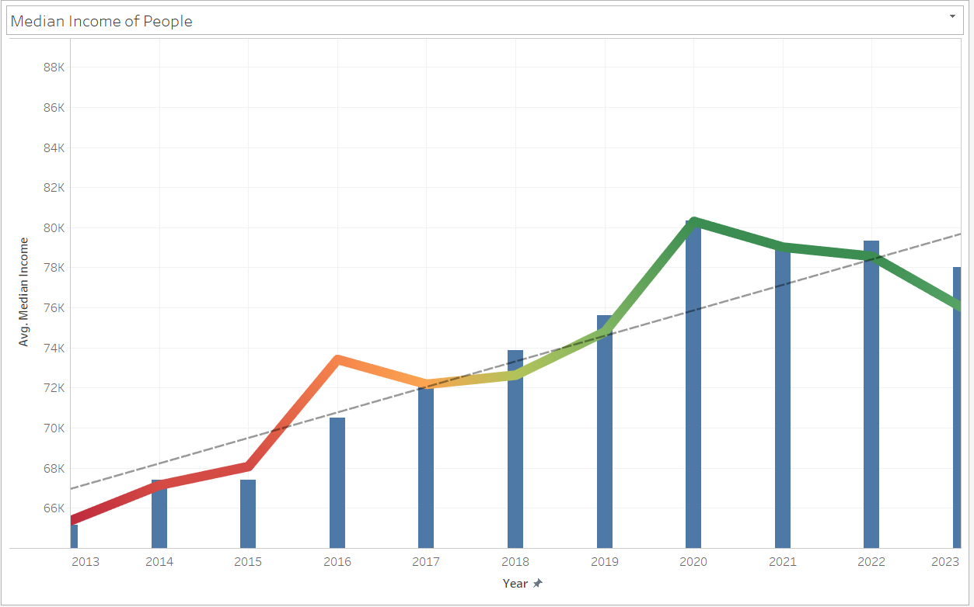

Average Median Income

Slide 9
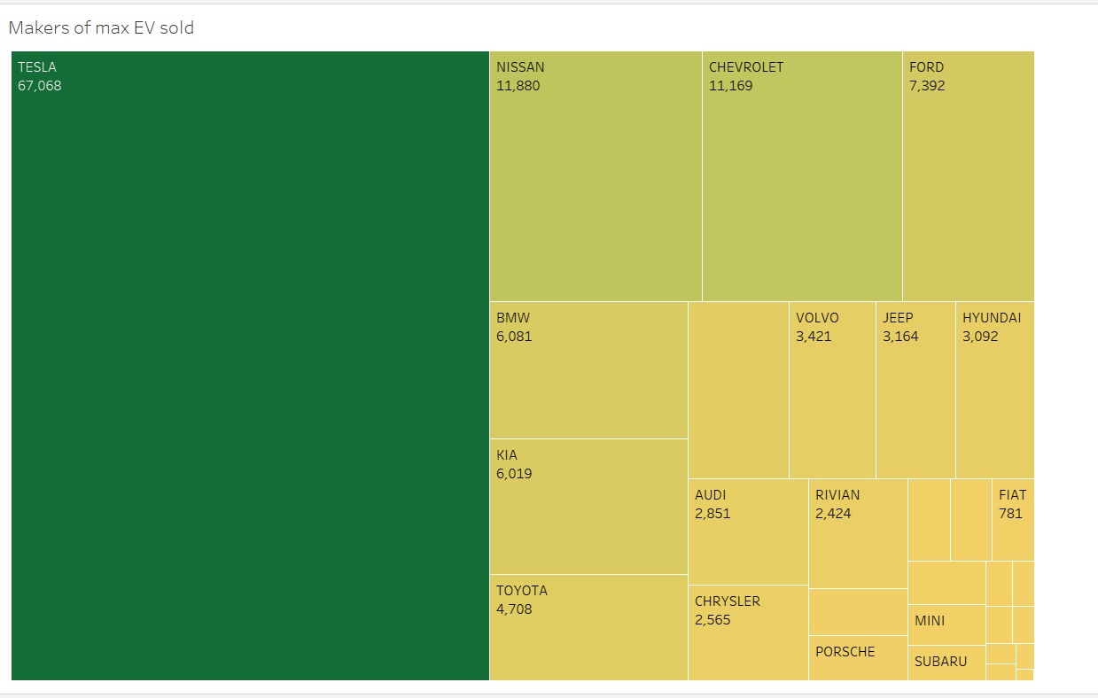
Highest SOLD EV’s

Slide 10
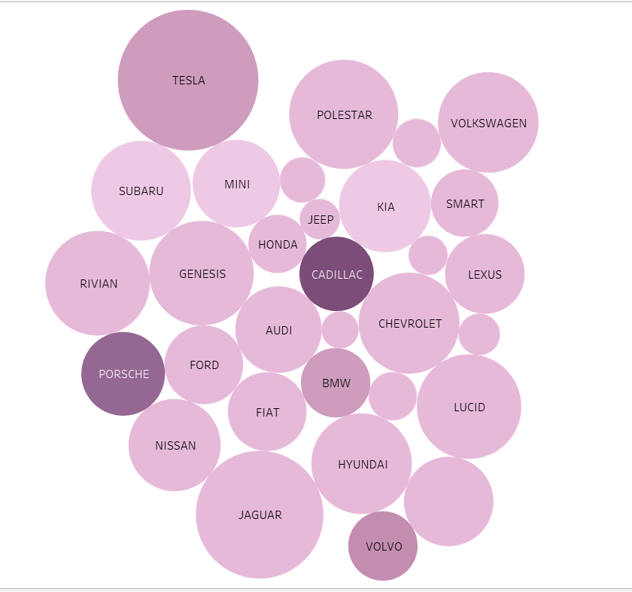
Range and Price of EV’s
Bigger circle represents higher range
Dark color represents high MSRP
Ideal combination is big circle but lighter shade of purple.

Slide 11
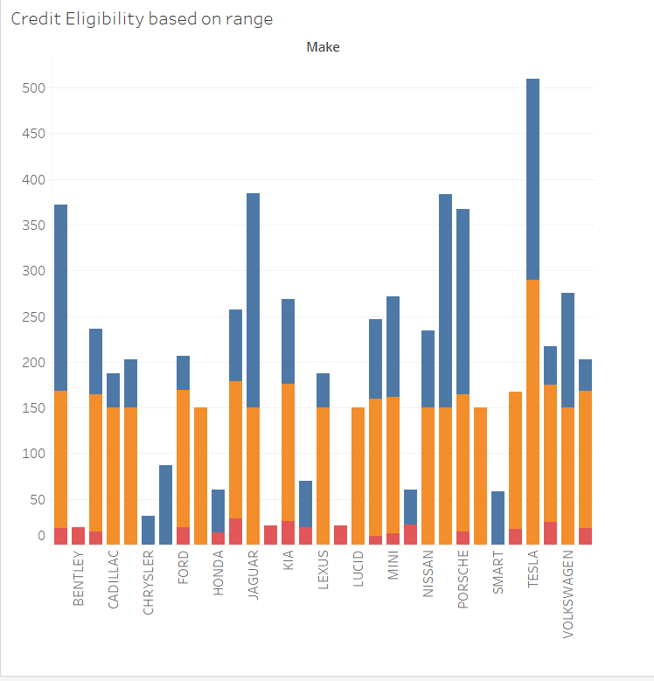
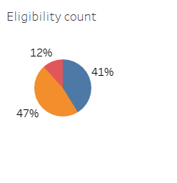
Credit Eligibility Of EV
Eligibility by maker
Count of Eligible Cars

Slide 12
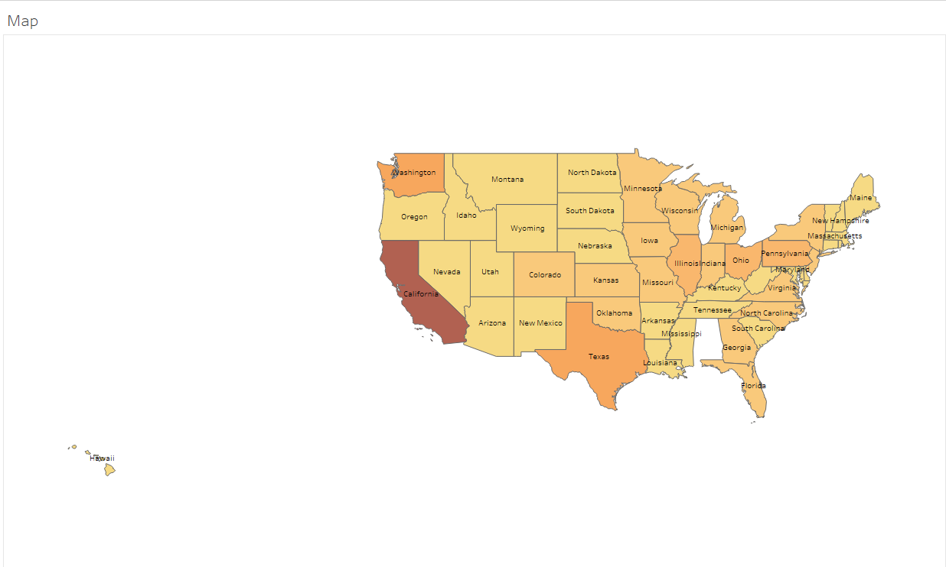
MAp
Dark brown color represents high count of EV in that state.

Slide 13
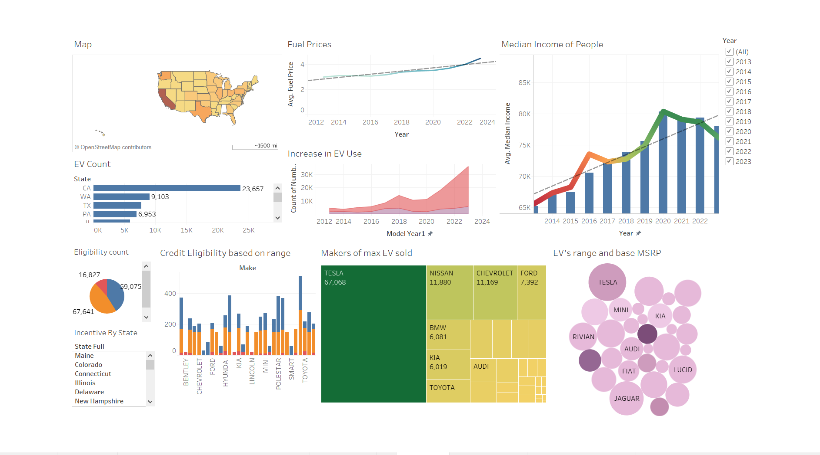
Storyboard

Slide 14
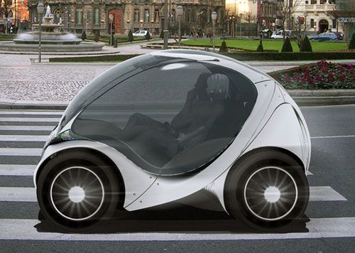

Conclusion
Policy Makers must continue to support the EV adoption through incentives
Consumers are embracing and must continue choosing or plug-in hybrids for a sustainable future
Manufacturers must invest more on innovation in technology where the car prices can further be reduced . They also must work in improving the charging infrastructure all over the country to increase their sales.

Slide 15

Thank you
This Photo by Unknown Author is licensed under CC BY-NC-ND

